Slide 1

SQL Server 2005
Partitioning Concepts
C3: Protected

Slide 2

About the Author
Created By: | Mahua Saha (103924)
Credential Information: | 9+ years SysAdmin / DBA experience
Version and Date: | V 1.0 26-March-2008
Cognizant Certified Official Curriculum

Slide 3









Icons Used
Hands on Exercise
Questions
Tools
Coding Standards
Test Your Understanding
Reference
A Welcome Break
Contacts
Demonstration

Slide 4

Partitioning: Overview
Introduction:
Partitioned tables are a new feature available in SQL Server version 2005, aimed mainly at improving the performance of large database systems. The feature is only available for Enterprise and Developer editions. For other Editions one can get a similar functionality with a partitioned view.

Slide 5

Partitioning: Objectives
Objective:
After completing this chapter, you will be able to:
  Understand the need for partitioning.
  Define
    Range Partitioning
    Partitioning key
    Index and list partitioning
  Create a partitioned table.
  Understand splitting, merging and switching partitions.
  Understand sliding window scenario.

Slide 6
Why Partition?
Partitioning increases the availability of mission-critical databases. If critical
tables and indexes are divided into partitions. Partitioning can significantly
reduce the impact of scheduled downtime for maintenance operations and
recovery window from failures:
Allows partitions to be maintained by “switching” partitions in and out of the partitioned table.
Can load data into a new partition of existing partitioned table with minimal disruption in data access in the remaining partitions.
Can load data into a new partition of existing partitioned table with performance equal to loading the same data into a new empty table.
Archive and/or remove a portion of a partitioned table with minimal impact on access to the remainder of the table.
Note: Partitioned tables and indexes are supported in Microsoft SQL Server 2005 Enterprise and Developer editions only.
Notes:
This is the content slide. Enter the content for the topic in this slide. Ensure that comprehensive speaker notes are available for each slide.

Slide 7
Why Partition?
An area that gets tremendous benefit from partitioning is historical data management, including data archival or data migration. Sliding window can be used to determine what data is to be kept online and what data to be taken off-line or prune.
Partitioning can be implemented without requiring any modifications to applications. For example, a non-partitioned table can be converted to a partitioned table without the need to modify any of the SQL statements that access the table. Also no changes in the application code are required to take advantage of partitioning.
Improves query performance drastically and offers better scaling and parallelism for extremely large operations over multiple related tables.
Provides a flexible filegroup backup strategy that will help in large database scenarios. By placing tables on individual partitions of partitioned tables, on specific filegroups, a granular backup and restore strategy can be devised which will enable a part of the database to be restored quickly.
Notes:
This is the content slide. Enter the content for the topic in this slide. Ensure that comprehensive speaker notes are available for each slide.

Slide 8
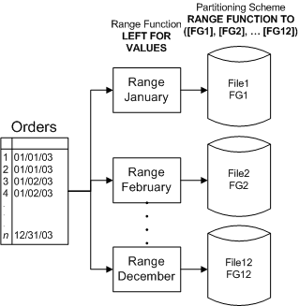
Range Partitions
Range partitions are table partitions that are defined by specific and customizable ranges of data. The range partition boundaries are chosen by the developer, and can be changed as data usage patterns change.
Figure 1. Range partitioned table with 12 partitions

Slide 9
Range Partitions (contd..)
The primary use of range partitions is for data archiving, decision support and for combined OLTP and Decision Support Systems (DSS) where data usage varies over the life cycle of a row.

Slide 10
Partitioning Terminologies
The first step in partitioning tables and indexes is to define the data on which the partition is keyed.
A partitioning key is a column that is used to determine the partition in which a particular row of data is stored. The partitioning key for a range function can consist of only one column.
The partition function defines the data type on which the key (also known as the logical separation of data) is based. The function defines this key but not the physical placement of the data on disk. The scope of a partition function is limited to the database that it is created in.
The placement of data is determined by the partition scheme. A partition scheme can use only one partition function. However, a partition function can participate in more than one partition scheme. The scheme maps the data to one or more filegroups that map the data to specific file(s) and therefore disks.
Notes:
The partitioning key will typically contain numeric or date/time values, others are also permitted - with exception of timestamp, text, image, XML, varchar(max), varbinary(max), CLR user-defined, and alias data types.
A partition function defines how the rows of a table or index are mapped to a set of partitions based on the values of certain columns, called partitioning columns. The choices for the partitioning column and the values range are determined primarily by the extent to which the data can be grouped in a logical way, such as by date.
Two factors to be considered when planning a partition function are:
The column whose values determine how a table is partitioned – partitioning column
Range of values of the partitioning column for each partition. This range of values determine the number of partitions that make up a table. A table can have a maximum of 1,000 partitions.
Partition scheme assigns each of the partitions to a specific filegroup. The primary reason for placing partitions on separate filegroups is to independently perform backup operations on partitions.

Slide 11
Index Partitioning and List Partitioning
Index Partitioning
In addition to partitioning a table's dataset, you can partition indexes.
Partitioning both the table and its indexes using the same function often optimizes performance. When the indexes and the table use the same partitioning function and columns in the same order, the table and index are aligned.
List Partitioning
List partitioning allows users to have explicit control over how rows map to partitions. This is done by specifying a list of discrete values for the partitioning column in the description for each partition.
Notes:
If an index is created on an already partitioned table, SQL Server automatically aligns the new index with the table's partitioning scheme unless the index is explicitly partitioned differently.
When a table and its indexes are aligned, then SQL Server can move partitions in and out of partitioned tables more effectively, because all related data and indexes are divided with the same algorithm.
When the tables and indexes are defined with not only the same partition function but also the same partition scheme, they are considered to be storage-aligned.
One benefit to storage alignment is that all data within the same boundary is located on the same physical disk(s).

Slide 12
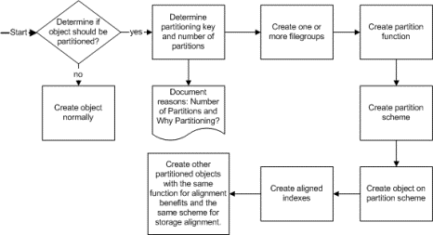
Steps for Creating Partitioned Tables
The logical flow is as follows:
Figure 2: Steps to create a partitioned table or index
Notes:
Now that you have an understanding of the value of partitioned tables, the next section details the process of implementing a partitioned table, and the features that contribute to this process.
Determine If Object Should Be Partitioned
While partitioning can offer great benefits, it adds administrative overhead and complexity to the implementation of your objects, which can be more of a burden than a gain. Specifically, you might not want to partition a small table, or a table that currently meets performance and maintenance requirements. The sales scenario mentioned earlier uses partitioning to relieve the burden of moving rows and data—you should consider whether your scenario has this sort of burden when deciding whether to implement partitioning.
Determine Partitioning Key and Number of Partitions
If you are trying to improve performance and manageability for large subsets of data and there are defined access patterns, range partitioning can alleviate contention as well as reduce maintenance when read-only data does not require it. To determine the number of partitions, you should evaluate whether or not logical groupings and patterns exist within your data. If you often work with only a few of these defined subsets at a time, then define your ranges so the queries are isolated to work with only the appropriate data (i.e. only the specific partition).
Determine If Multiple Filegroups Should Be Used
To help optimize performance and maintenance, you should use filegroups to separate your data. The number of filegroups is partially dictated by hardware resources: it is generally best to have the same number of filegroups as partitions, and these filegroups often reside on different disks. However, this primarily only pertains to systems where analysis tends to be performed over the entire dataset. When you have multiple CPUs, SQL Server can process multiple partitions in parallel and therefore significantly reduce the overall processing time of large complex reports and analysis. In this case, you can have the benefit of parallel processing as well as switching partitions in and out of the partitioned table.

Slide 13
Create Filegroups
Using ALTER DATABASE, you can add a logical filegroup name, and then add files.
To create a filegroup named 2003Q3 for the AdventureWorks database, use ALTER DATABASE in the following way:
ALTER DATABASE AdventureWorks ADD FILEGROUP [2003Q3]
Once a filegroup exists, you use ALTER DATABASE to add files to the filegroup.
  ALTER DATABASE AdventureWorks ADD FILE (NAME = N'2003Q3', FILENAME = N'C:\AdventureWorks\2003Q3.ndf', SIZE = 5MB, MAXSIZE = 100MB, FILEGROWTH = 5MB) TO FILEGROUP [2003Q3]
Notes:
Create Filegroups
If you want to place a partitioned table on multiple files for better I/O balancing, you will need to create at least one filegroup. Filegroups can consist of one or more files, and each partition must map to a filegroup. A single filegroup can be used for multiple partitions but for better data management, such as for more granular backup control, you should design your partitioned tables so that only related or logically grouped data resides on the same filegroup. Using ALTER DATABASE, you can add a logical filegroup name, and then add files.
A table can be created on a file(s) by specifying a filegroup in the ON clause of CREATE TABLE.
However, a table cannot be created on multiple filegroups unless it is partitioned.
To create a table on a single filegroup, use the ON clause of CREATE TABLE.
To create a partitioned table, you must first have a functional mechanism for the partitioning. The criteria on which you partition are logically separated from the table in the form of a partition function.
This partition function will exist as a separate definition from the table and this physical separation helps because multiple objects can use the partition function. Therefore, the first step in partitioning a table is to create the partition function.

Slide 14
How to Create a Partition Function
Use the CREATE PARTITION FUNCTION Transact-SQL command to create a partition function. The general syntax for this command is as follows:
CREATE PARTITION FUNCTION partition_function_name ( input_parameter_type ) AS RANGE [ LEFT | RIGHT ] FOR VALUES ( [ boundary_value [ ,...n ] ] ) [ ; ]
Range partitioning is the only type of partitioning that SQL Server 2005 supports.
Notes:
You first give the partition function a name that conforms to the rules for object identifiers. Then you must specify a data type for the input parameter. You can use any data type except text, ntext, varchar(max), image, xml, timestamp, nvarchar(max), varbinary( max), Transact-SQL user-defined data types (UDTs), and common language runtime (CLR) data types.
In the command's RANGE clause, you specify a value of either RIGHT or LEFT to specify which partition a boundary point value belongs in. And in the VALUES clause, you specify the list of boundary points for the partition function.

Slide 15
How to Create a Partition Function
To explain how to use this command, let's look at the
following example:
CREATE PARTITION FUNCTION partfunc (int) AS RANGE LEFT FOR VALUES (1000,
2000, 3000, 4000, 5000);
The partition function partfunc defines six partitions, as Table 1 shows.
If you defined the partition function as RANGE RIGHT instead of RANGE LEFT, the
values would map as shown in Table 2.
Partition ID | Range of Values
1 | –infinity to 1,000
2 | 1,001 to 2,000
3 | 2,001 to 3,000
4 | 3,001 to 4,000
5 | 4,001 to 5,000
6 | 5,001 to +infinity
Partition ID | Range of Values
1 | –infinity to 999
2 | 1,000 to 1,999
3 | 2,000 to 2,999
4 | 3,000 to 3,999
5 | 4,000 to 4,999
6 | 5,000 to +infinity
Table 2. Partition Values If Partition Function Were Defined as RANGE RIGHT
Table 1. Partition Function partfunc's Six Partitions
Notes:
This command creates a partition function named partfunc that is applied to values of data type integer. This means that you cannot apply the function to columns that either are not defined as an integer data type or are not implicitly converted to an integer data type.
The RANGE LEFT clause in the example specifies that each boundary point defined for the function resides in the left-hand partition. The VALUES clause defines the boundary points for the partitions. A partition function always maps the entire range of allowed values without any holes, so every possible value is always defined to a specific partition.
Note that a partition function does not do the following:
Specify a table, index, or indexed view
Specify a filegroup
Reference physical data of any kind
The partition scheme and table or index creation statement uses a stand-alone database object to implement partitioning.

Slide 16
Creating a Partition Scheme
The second step of partitioning a table, index, or indexed view is creating a partition scheme.
The partition scheme defines the physical storage structures, or filegroups, that will be used with a specific partition function. Here you will see how to create a partition scheme that maps partitions to filegroups.
You use the CREATE PARTITION SCHEME Transact-SQL command to create a partition scheme. The general syntax for this command is as follows:
CREATE PARTITION SCHEME partition_scheme_name AS PARTITION partition_function_name TO ( { file_group_name | [ PRIMARY ] } [ ,...n ] )[ ; ]

Slide 17
Creating a Partition Scheme (contd..)
The following example shows how to use the command to define a partition scheme called partscheme:
CREATE PARTITION SCHEME partscheme AS PARTITION partfunc TO ([FG1], [FG2], [FG3], [FG4], [FG5], [FG6]) GO
Notice that we still have not specified a table, view, or indexed view or referenced any other object in the database with the exception of the partition function. A partition scheme simply specifies a name for a physical storage structure.
Notes:
Once you have created a partition function, you must associate it with a partition scheme to direct the partitions to specific filegroups.
When you define a partition scheme, you must make sure to name a filegroup for every partition, even if multiple partitions will reside on the same filegroup.
The partition function partfunc had six partitions. Based on the partition scheme definition, SQL Server stores any values that reside in Partition 1 in FG1, values in Partition 2 in FG2, values in Partition 3 in FG3, and so on. So by carefully designing your partition functions and partition schemes, you can determine the exact set of data within a table, index, or indexed view that resides within a particular filegroup.

Slide 18
Partitioning Tables and Indexes
After you create a partition function and a partition scheme, you are ready to partition a table, index, or indexed view.
The general syntax of the CREATE TABLE Transact-SQL command is as follows:
CREATE TABLE [ database_name . [ schema_name ] . | schema_name . ] table_name ( { <column_definition> | <computed_column_definition> } [ <table_constraint> ] [ ,...n ] ) [ ON { partition_scheme_name ( partition_column_name ) | filegroup | "default" } ] [ { TEXTIMAGE_ON { filegroup | "default" } ] [ ; ]
The general syntax of the CREATE INDEX Transact-SQL command is as follows:
CREATE [ UNIQUE ] [ CLUSTERED | NONCLUSTERED ] INDEX index_name ON <object> ( column [ ASC | DESC ] [ ,...n ] ) [ INCLUDE ( column_name [ ,...n ] ) ] [ WITH ( <relational_index_option> [ ,...n ] ) ] [ ON { partition_scheme_name ( column_name ) | filegroup_name | default } ][ ; ]
Notes:
With the partition function (the logical structure) and the partition scheme (the physical structure) defined, the table can be created to take advantage of them. The table defines which scheme should be used, and the scheme defines the function. To tie all three together, you must specify the column to which the partitioning function should apply. Range partitions always map to exactly one column of the table that should match the datatype of the boundary conditions defined within the partition function. Additionally, if the table should specifically limit the data set (rather than from –infinity to positive infinity), then a check constraint should be added as well.

Slide 19
Partition Elimination
Data partition elimination refers to the database server’s ability to determine,
based on the query predicates, which subset of the data partitions of a table need
to be accessed to answer a query.
If a query includes a partition key as a predicate in the WHERE clause, SQL
Server will automatically route the query to the partition or partitions that are
associated with the query, eliminating (and not searching) those partitions that
will not have data included in the result set.
There are basically two types of partition elimination:
Static partition elimination
Dynamic partition elimination
Notes:
SQL Server eliminates partitions statically at compile time when it knows the exact list of partitions to scan (i.e,) the where clause of the query includes the partition key and specifies a specific range or value. In case of a parameterized query like below, SQL Server will try to eliminate partitions at run time if possible

Slide 20
Partition Elimination (contd..)
The benefits of partition elimination at query time are very significant when running decision support queries against a partitioned table and also improve performance since SQL Server significantly reduces the amount of table data and index information that are to be searched to return results.

Slide 21
Splitting, Merging and Switching Partitions
The main objective of partitioning is Manageability and ease of Administration.
The Split, Merge and Switch functions aid to either move data in to or out of the partitioned table.
To add another partition to the table, split an existing partition into two partitions and redefine the boundaries of the new partitions.
To remove a partition, first switch out a partition of a table – to a non-partitioned table within the same filegroup and then merge the previous boundary point and thereby remove that boundary point and hence remove the partition.

Slide 22
Sliding Window
SQL Server 2005 partitioning makes it very easy to prune old data from a large partitioned table. It can be done easily by creating an empty pseudo-partition and then switching it into the partitioned table. The pseudo-partition can be backed up, truncated, or dropped, as appropriate. Optionally, the partition function can also be redefined to merge all of the empty partitions together into one.
Sliding Window is one of the key factors influencing partitioning for relational data warehouses. This section will illustrate how to roll in new partitions and roll aged partitions out of the partitioned table. The significance of this is that new data will be available for the users to query while the aged data is being archived. The key here is to minimize downtime while moving the partitions.
Note:
The sliding window scenario works only when the target table or partition is empty.
For switching partitions from one partitioned table to another
the staging table must be created on the same filegroup of the partition, with the exact same definition and clustered index.
Both tables must be partitioned on the same column.
Notes:
When the next month's data is available, October 2004 in this case, there is a specific sequence of steps to follow to use the existing filegroups and to switch the data in and out. In this sales scenario, the data currently in FG1 is data from October 2002. Now that the data for October 2004 is available, you have two options depending on available space and archiving requirements. Remember, in order to switch a partition in or out of a table quickly, the switch must change metadata only.
However, if you do not have enough space to keep both the current month and the month to be archived, then you will need to switch the old partition out (and remove or drop it) first.
Regardless, archiving should be easy and is probably already being done. A good practice for archiving is to back up the filegroup immediately after the new partition is loaded and switched in, not just before you plan to switch it out.

Slide 23

Time for a Break !

Slide 24

Test Your Understanding
What does the RANGE clause of the CREATE PARTITION FUNCTION command define?
What does the VALUES clause of the CREATE PARTITION FUNCTION command define?
What does a partition scheme define?
What are the requirements for creating a partition scheme?
What are the three operations you can use to manage partitions, and what is the purpose of each?

Slide 25

Hands-on-exercise
Partitioning a Table :
  Create Filegroups
  First create a directory in any drive ( say C:\data ) where the filegroups are
  to reside. Then login as the System Administrator ’sa’ on the Server and
  execute the following script in the sample database ’AdventureWorks’ which
  will create 2 filegroups that will hold the data of years 2001 till 2004.
  ALTER DATABASE AdventureWorks ADD FILEGROUP FG_2001
  GO
  ALTER DATABASE AdventureWorks ADD FILEGROUP FG_2002
  GO
  ALTER DATABASE AdventureWorks ADD FILEGROUP FG_2003
  GO
  ALTER DATABASE AdventureWorks ADD FILEGROUP FG_2004
  GO

Slide 26
Hands-on-exercise
Add Files to the Filegroup:
  Create one file in each of the four filegroups.
ALTER DATABASE AdventureWorks
  ADD FILE
  (NAME = N'FG_2001',
  FILENAME = N'C:\Data\FG2001.ndf',
  SIZE = 5MB,
  MAXSIZE = 150MB,
  FILEGROWTH = 5MB)
  TO FILEGROUP FG_2001
  GO
  ALTER DATABASE AdventureWorks
  ADD FILE
  (NAME = N'FG_2002',
  FILENAME = N'C:\Data\FG2002.ndf',
  SIZE = 5MB,
  MAXSIZE = 150MB,
  FILEGROWTH = 5MB)
  TO FILEGROUP FG_2002
  GO
  ALTER DATABASE AdventureWorks
  ADD FILE
  (NAME = N'FG_2003',
  FILENAME = N'C:\Data\FG2003.ndf',
  SIZE = 5MB,
  MAXSIZE = 150MB,
  FILEGROWTH = 5MB)
  To FILEGROUP FG_2003
  GO
  ALTER DATABASE AdventureWorks
  ADD FILE
  (NAME = N'FG_2004',
  FILENAME = N'C:\Data\FG2004.ndf',
  SIZE = 5MB,
  MAXSIZE = 150MB, FILEGROWTH = 5MB)
  TO FILEGROUP FG_2004
  GO

Slide 27
Hands-on-exercise
Create Partition Function using Date Range:
Create a partition function, with 4 boundary points. This would create 5
partitions. For efficient data management in the sliding window a LEFT-
based partition function will have an empty partition on the far right and a
RIGHT-based partition function will have an empty partition on the far
LEFT. This will ensure that no rows move.
  CREATE PARTITION FUNCTION PFN_OrderDateRange(datetime)
  AS
  RANGE LEFT FOR VALUES ('20010101 23:59:59.997',
  '20020101 23:59:59.997',
  '20030101 23:59:59.997',
  '20040101 23:59:59.997' )
Note: A partition function defines logical boundary points, not the specific location on which
the partitions should reside. Also regardless of LEFT or RIGHT, a range partition function must
include all values up to infinity in both directions.
Notes:
Range partitions must be defined with boundary points. It must include all values that will reside in the table and should be restricted through a CHECK constraint. Since data is likely to be switched in and out of the partition, an empty partition should also be maintained to make room for future data. It is not a requirement of partitioning that the partition boundaries be equally spaced, nor do they have to follow a specific pattern, such as months or quarters.
The LEFT, RIGHT keyword in the definition specifies whether the boundary condition is an upper boundary in the first partition (LEFT) or a lower boundary in second partition (RIGHT). In other words if the first value (or boundary condition) of a partition function is ‘20001001’ then the values within the bordering partitions will be:
For LEFT
1st partition is all data <= ‘20001001’
2nd partition is all data > ‘20001001’
For RIGHT
1st partition is all data < ‘20001001’
2nd partition is all data => ‘20001001’
With range RIGHT, the default time is 12:00:00.000 am. For LEFT the complexity is due to the precision of the datetime datatype. The reason that 23:59:59.997 must be chosen is because datetime data does not guarantee precision to the millisecond. Instead, datetime data is precise within 3.33 milliseconds. So care has to be taken while defining boundary conditions on Datetime data type.
Create a partition function, with 4 boundary points. This would create 5 partitions. For efficient data management in the sliding window a LEFT-based partition function will have an empty partition on the far right and a RIGHT-based partition function will have an empty partition on the far LEFT. This will ensure that no rows move.
Boundary point ‘20010101 23:59:59.997’ as LEFT (sets the pattern):
The LEFT most partition will include all values <= ‘20010101 23:59:59.997’
Boundary point ‘20020101 23:59:59.997’:
The SECOND partition will include all values > ‘20010101 23:59:59.997’ but <= ‘20020101 23:59:59.997’
Boundary point ‘20030101 23:59:59.997’:
The THIRD partition will include all values > ‘20020101 23:59:59.997’ but <= ‘20030101 23:59:59.997’
Boundary point ‘20040101 23:59:59.997’:
The FORTH partition will include all values > ‘20030101 23:59:59.997’ but <= ‘20040101 23:59:59.997’
Finally, a FIFTH partition will include all values > ‘20040101 23:59:59.997’.
RANGE RIGHT FOR VALUES ('20010101 00:00:00.000',
'20020101 00:00:00.000',
'20030101 00:00:00.000',
'20040101 00:00:00.000')

Slide 28
Hands-on-exercise
Create Partition Scheme:
  Once a partition function is created, it must be associated with a partition scheme to direct the partitions to specific filegroups. When a partition scheme is defined, a filegroup should be named for every partition, even if multiple partitions will reside on the same filegroup.
    CREATE PARTITION SCHEME PSCHM_OrderDate
    AS
    PARTITION PFN_OrderDateRange
    TO ([FG_2001], [FG_2002], [FG_2003], [FG_2004], [PRIMARY])
  A partition scheme can map each partition to a different filegroup, or map multiple partitions to the same file group else map all partitions to the same filegroup.

Slide 29
Hands-on-exercise
Create Partitioned Table:
  To create a partitioned table, the table must include a column with the data type used in the creation of the partition function. The ON clause defines which partitioning scheme the table uses (PSCHM_OrderDate) and the column of the table that dictates how the rows are partitioned.
To partition a table or index at the time of creation, the following should be
specified in the CREATE TABLE or CREATE INDEX statement:
  The partition scheme that the table will use to map the partitions to filegroups.
  The column on which to partition the table (the partitioning column). The partitioning column must match that specified in the partition function that the partition scheme is using in terms of data type, length, and precision.
Notes:
This table will store data from year 2001 till year 2004. To enforce this, a check constraint will be added to the OrderDate column. System tables sys.partitions and sys.partition_range_values can be queried to view information about the partitioned table:

Slide 30
Hands-on-exercise
    CREATE TABLE [dbo].[TBL_OrdersRange]
    ( SalesOrderID [int] NOT NULL,
    ContactID [int] NOT NULL,
    SubTotal [money] NOT NULL,
    SalesPersonID [int] NULL,
    TotalDue [money] NULL,
    CustomerID [int] NULL,
    OrderDate [datetime] NOT NULL
    CONSTRAINT CHK_OrdersRangeYear
    CHECK ([OrderDate] >= '20010101'
    AND [OrderDate] <= '20041231 11:59:59.997')
    ) ON PSCHM_OrderDate(OrderDate)
  This table will store data from year 2001 till year 2004. To enforce this, a check constraint will be added to the OrderDate column.
  System tables sys.partitions and sys.partition_range_values can be queried to view information about the partitioned table:

Slide 31
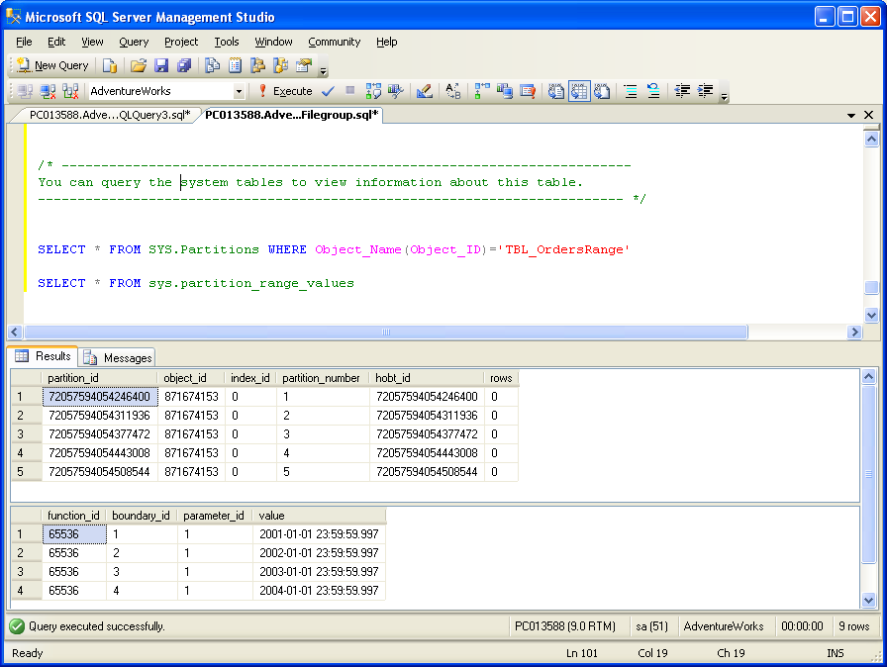
Hands-on-exercise
SELECT * FROM SYS.Partitions WHERE Object_Name(Object_ID)='TBL_OrdersRange'
SELECT * FROM sys.Partition_Range_Values
Since no rows have been inserted into the table, the values in ’rows’ column are
currently zero. Now insert data into the partitioned table, from the sample database AdventureWorks

Slide 32
Hands-on-exercise
  INSERT dbo.[TBL_OrdersRange]
  SELECT o.[SalesOrderID]
  , o.[ContactID]
  , o.[SubTotal]
  , o.[SalesPersonID]
  , o.[TotalDue]
  , o.[CustomerID]
  , o.[OrderDate]
  FROM AdventureWorks.Sales.SalesOrderHeader AS o
  WHERE ([OrderDate] >= '20011001'
  AND [OrderDate] < '20043101')
  GO

Slide 33
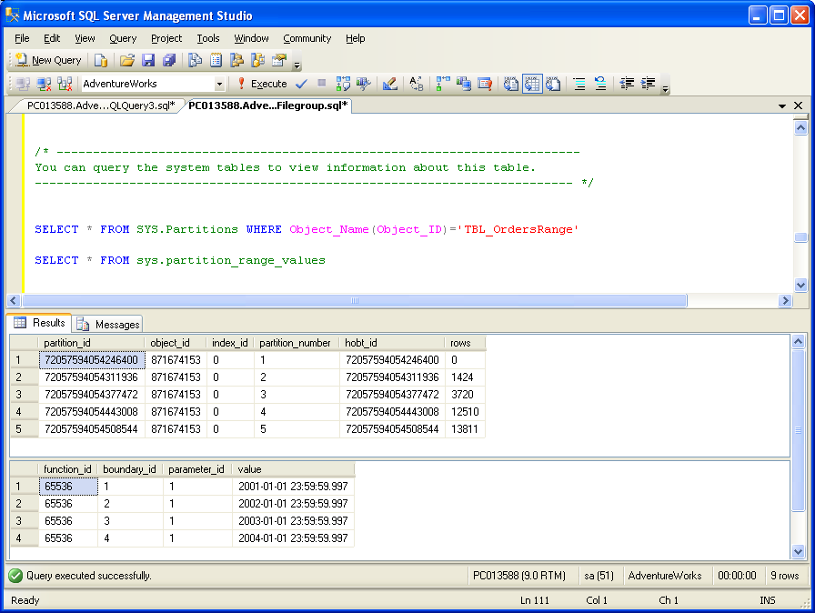
Hands-on-exercise
Now query the system tables to view the partitioned table info using the same query. The results show how many rows are there in each partition, along with the partition_id and the partition_number.

Slide 34
Hands-on-exercise
Create a clustered index on the table on Orderdate and Salesorder ID. By default SQL Server will align the index with the partitioned table on the same scheme.The scheme need not be specified explicitly.
  ALTER TABLE TBL_OrdersRange
  ADD CONSTRAINT PK_Orders
  PRIMARY KEY CLUSTERED (OrderDate, SalesOrderID)
Use sp_helptext, to see that the index has been aligned to the same partition scheme – PSCHM_OrderDate.
Notes:
Note:
If there is a partitioned clustered index and that clustered index is dropped, then the new heap will remain partitioned. It will be located on the same partition scheme or filegroup, as was defined for the clustered index, unless MOVE TO option is specified while dropping the clustered index. Also, since the leaf level of a clustered index and the data pages are the same by definition, creating a clustered index and using the ON partition_scheme_name or ON filegroup_name clause effectively moves a table from the filegroup on which the table was created to the new partition scheme or filegroup.

Slide 35
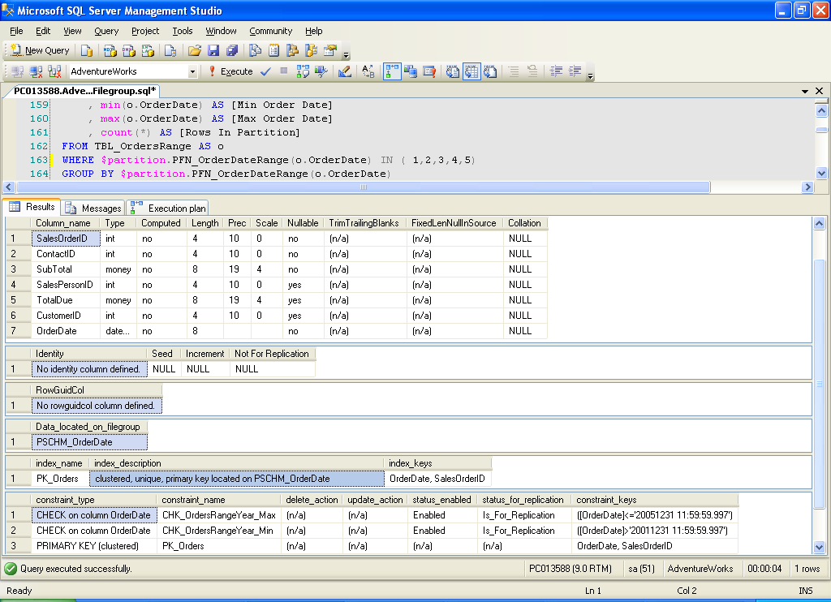
Hands-on-exercise

Slide 36
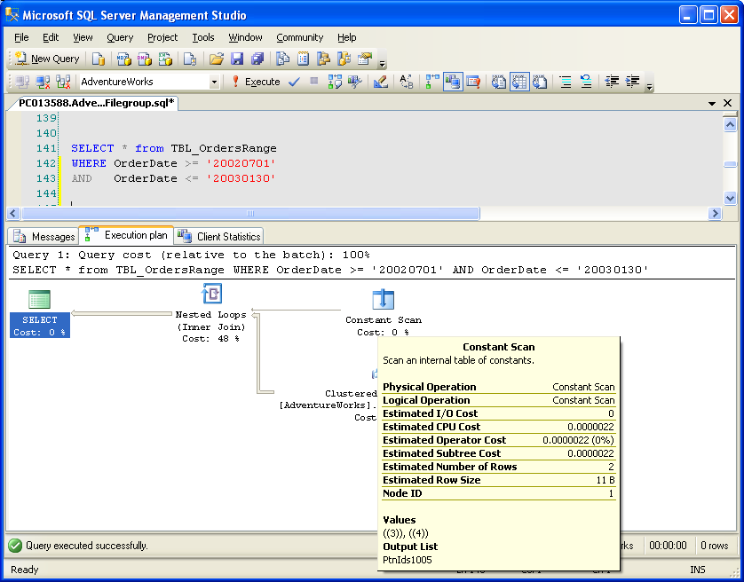
Hands-on-exercise
Static partition elimination
    Query the partitioned table to return data between 07-01-2002 and 30-
    01-2003, and examine the execution plan
SELECT * from TBL_OrdersRange WHERE OrderDate >= '20020701' AND OrderDate <= '20030130'

Slide 37
Hands-on-exercise
On reading the execution plan, one can observe SQL Server eliminating all unnecessary partitions and choosing only those that contain the related data - PARTITION ID:([PtnIds1005]) in the Output List section. SQL Server explicitly enumerates the partition ids that the table scan must touch using the constant scan and nested loops join operators.
A Nested Loops join operator is produced when the two table partitions are joined to satisfy the query.
A Constant Scan operator also appears immediately after the Nested Loops join operator and the two partitions ((3)) and ((4)) that are joined to satisfy this query are identified in the Values attribute that is listed for the Constant Scan operator.

Slide 38
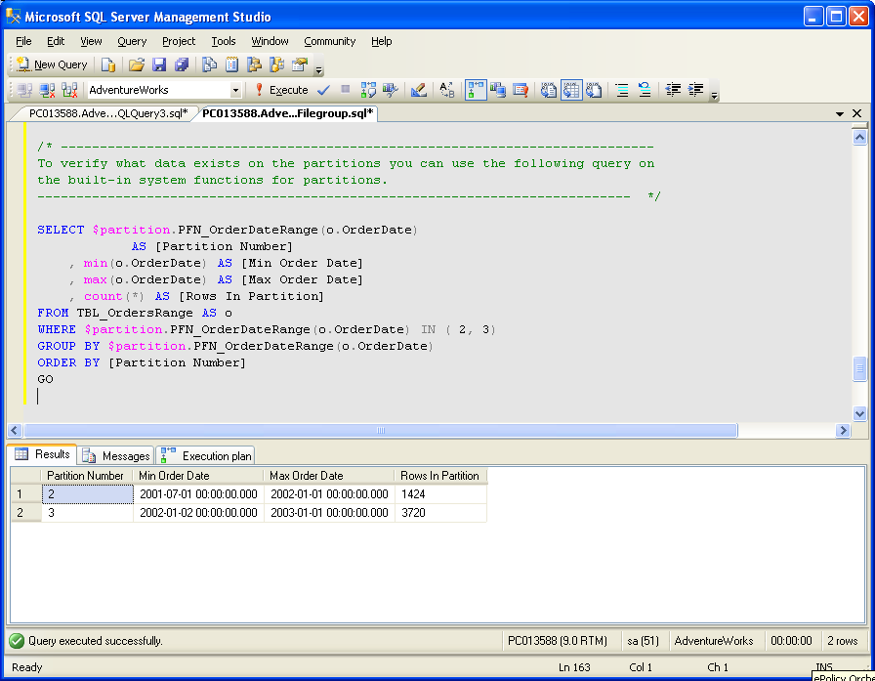
Hands-on-exercise
Verify what data exists on the partitions ( e.g. 2, 3 ) use the following query on the built-in system functions for partitions:
SELECT $partition.PFN_OrderDateRange(O.OrderDate) AS [Partition Number] ,
min(O.OrderDate) AS [Min Order Date] ,
max(O.OrderDate) AS [Max Order Date] ,
count(*) AS [Rows In Partition]
FROM TBL_OrdersRange AS O
WHERE $partition.PFN_OrderDateRange(o.OrderDate) IN (2,3)
GROUP BY $partition.PFN_OrderDateRange(o.OrderDate)
ORDER BY [Partition Number]

Slide 39
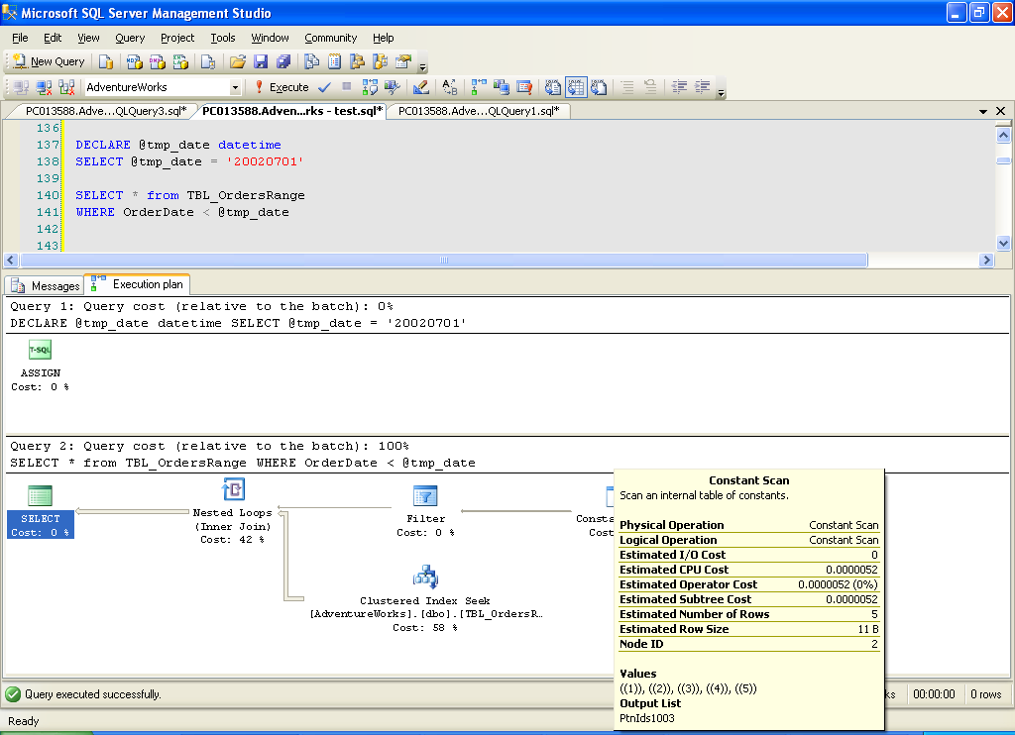
Hands-on-exercise
Dynamic partition elimination:
  Issue a parameterized query and examine the execution plan:
  DECLARE @tmp_date datetime
  SELECT @tmp_date = '20020701'
  SELECT * from TBL_OrdersRange
  WHERE OrderDate < @tmp_date

Slide 40
Hands-on-exercise
In the above query the actual parameter value is not known until run
time and there is no way to determine at compile time which partition
ids are to be scanned, So the constant scan enumerates all five
partition ids and a filter to eliminate partitions ids at run time. This is
dynamic partition elimination.

Slide 41
Hands-on-exercise
Dynamic partition elimination:
  Issue a parameterized query and examine the execution plan:
  DECLARE @tmp_date datetime
  SELECT @tmp_date = '20020701'
  SELECT * from TBL_OrdersRange
  WHERE OrderDate < @tmp_date

Slide 42
Time for a Break !

Slide 43
Partitioned and Non Partitioned Tables – Performance evaluation (Case Study)
Create a partitioned table ‘TBL_OrderDetails’ on the same partiton scheme, which stores the detail information of Orders.
  CREATE TABLE dbo.[TBL_OrderDetails](
  [SalesOrderID] [int] NOT NULL,
  [ProductID] [int] NULL,
  [UnitPrice] [money] NULL,
  [OrderQty] [smallint] NULL,
  [OrderDate] [datetime] NOT NULL
  CONSTRAINT CHK_OrderDetailsRangeYear
  CHECK ([OrderDate] >= '20010701'
  AND [OrderDate] <= '20040731 11:59:59.997') ,
  [ModifiedDate] [datetime] NOT NULL
  CONSTRAINT [DFLT_OrderDetailsModifiedDate]
  DEFAULT (getdate()),
  [LineTotal] AS (([UnitPrice]*[OrderQty])),
  ) ON
  PSCHM_OrderDate(OrderDate)

Slide 44
Partitioned and Non Partitioned Tables – Performance evaluation
Insert data in to the TBL_OrderDetails table.
  INSERT dbo.[TBL_OrderDetails]
  SELECT od.SalesOrderID ,
  od.ProductID ,
  od.UnitPrice ,
  od.OrderQty ,
  o.OrderDate ,
  od.ModifiedDate
  FROM AdventureWorks.Sales.SalesOrderDetail AS od
  JOIN AdventureWorks.Sales.SalesOrderHeader AS o
  ON o.SalesOrderID = od.SalesOrderID
  WHERE ([OrderDate] >= '20010101'
  AND [OrderDate] < '20041231')

Slide 45
Partitioned and Non Partitioned Tables – Performance evaluation
  Create another table which is not partitioned, with the same structure as TBL_OrderDetails and name in TBL_NonPartitioned_Details.
  SELECT * INTO TBL_NonPartitioned_Details FROM TBL_OrderDetails
  Create a Clustered Index on both the tables on columns OrderDate, SalesOrderID and ProductID.
  ALTER TABLE TBL_OrderDetails ADD CONSTRAINT PK_OrderDetails
  PRIMARY KEY CLUSTERED (OrderDate, SalesOrderID, ProductID)
  GO
  ALTER TABLE TBL_NonPartitioned_Details ADD CONSTRAINT PK_Details_NPTable
  PRIMARY KEY CLUSTERED (OrderDate, SalesOrderID, ProductID)
  GO

Slide 46
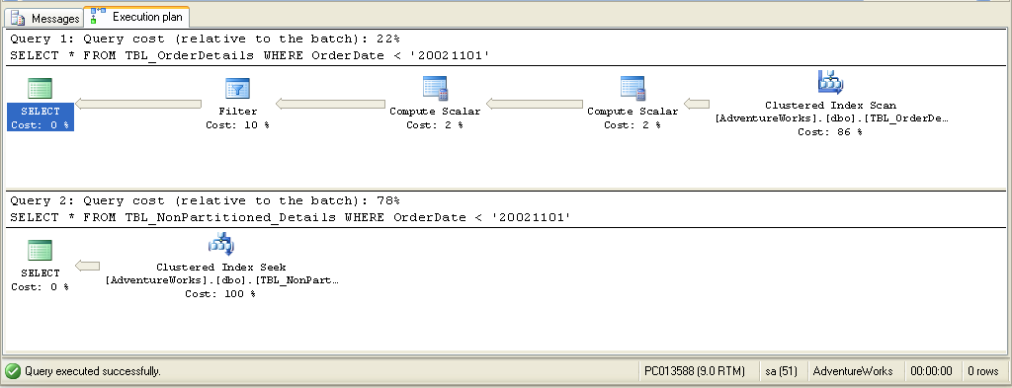
Partitioned and Non Partitioned Tables – Performance evaluation
SELECT * FROM TBL_OrderDetails WHERE OrderDate < '20021101' GO
SELECT * FROM TBL_NonPartitioned_Details WHERE OrderDate < '20021101'
Now query both the tables and examine the execution plan. The Query performance is drastically improved for partitioned table TBL_OrderDetails than the non-partitioned table TBL_NonPartitioned_Details.
Notes:
Note: A best practice is to restrict the partitioning key in the where clause, to either one partition or
reduce the number of partitions spanned.

Slide 47
Hands-on-exercise
Sliding Window
Create a staging table for the new data to be switched in:
First build a location for the new data to move into (a staging location) without disrupting the existing TBL_OrdersRange table. Some of the considerations are:
This staging table must have a constraint to restrict the data within the range of the new partition.
It must also have the same clustered index as the table in which it will become a partition.
For better performance load the data into an unindexed heap with no constraints and then add the WITH CHECK before switching the table into the partitioned table.
  ALTER DATABASE AdventureWorks ADD FILEGROUP FG_2005
  GO
  ALTER DATABASE AdventureWorks
  ADD FILE
  (
  NAME = N'FG_2005',
  FILENAME = N'C:\Data\FG2005.ndf',
  SIZE = 5MB,
  MAXSIZE = 150MB,
  FILEGROWTH = 5MB)
  TO FILEGROUP FG_2005
  GO

Slide 48
/* -----------------------------------------------------------------------------------------------------
Next, create a separate non-partitioned table in which to hold the data that will later become the new partition to the partitioned table.
--------------------------------------------------------------------- */
  CREATE TABLE [dbo].[TBL_OrdersRange_2005]
  ( SalesOrderID [int] NOT NULL,
  ContactID [int] NOT NULL,
  SubTotal [money] NOT NULL,
  SalesPersonID [int] NULL,
  TotalDue [money] NULL,
  CustomerID [int] NULL,
  OrderDate [datetime] NOT NULL )
  CONSTRAINT CHK_OrdersRangeYear_2005
  CHECK ([OrderDate] > '20050101'
  AND [OrderDate] <= '20051231 11:59:59.997') )

Slide 49
  ------- The Table should have the same index:
  ALTER TABLE TBL_OrdersRange_2005
  ADD CONSTRAINT PK_Orders_2005
  PRIMARY KEY CLUSTERED (OrderDate, SalesOrderID)
  GO
  -- The Table should have the same constraint:
  ALTER TABLE [dbo].[TBL_OrdersRange_2005]
  ADD CONSTRAINT CHK_OrdersRangeYear_STG
  CHECK ([OrderDate] <= '20051231 11:59:59.997')
  ALTER TABLE [dbo].[TBL_OrdersRange_2005]
  ADD CONSTRAINT CHK_OrdersRangeYear_STG2
  CHECK ([OrderDate] >= '20050101')
Notes:
Note: For switching partitions from one partitioned table to another,
The staging table must be created on the same filegroup of the partition, with the exact same definition and clustered index.
Both tables must be partitioned on the same column.

Slide 50
Create a staging table for the old data to be switched out
In this case of switching out the 2001 partition, which is on filegroup FG2001, an
empty table must be created on the same filegroup, which will hold the 2001 data
when the partition is switched out.
-- Create a staging table on FileGroup FG2001
CREATE TABLE [dbo].[STGTBL_OrdersRange_2001]
(
SalesOrderID [int] NOT NULL,
ContactID [int] NOT NULL,
SubTotal [money] NOT NULL,
SalesPersonID [int] NULL,
TotalDue [money] NULL,
CustomerID [int] NULL,
OrderDate [datetime] NOT NULL )
ON [FG_2001]
GO

Slide 51
Switching old data out
In order to switch out a partition, the partitioned table’s name and the
partition number which is being removed must be specified. Here, only
the partition is being removed from the partitioned table and the data is
not deleted, however, the data will not be seen via the TBL_OrdersRange
table any longer. The only access to this data is via the
STGTBL_OrdersRange_2001 table into which the partition’s data was
switched out.
-- Switch the old data out into the staging table
ALTER TABLE TBL_OrdersRange
SWITCH PARTITION 2
TO STGTBL_OrdersRange_2001
GO

Slide 52
Switching old data out
In order to switch out a partition, the partitioned table’s name and the
partition number which is being removed must be specified. Here, only
the partition is being removed from the partitioned table and the data is
not deleted, however, the data will not be seen via the TBL_OrdersRange
table any longer. The only access to this data is via the
STGTBL_OrdersRange_2001 table into which the partition’s data was
switched out.
-- Switch the old data out into the staging table
ALTER TABLE TBL_OrdersRange
SWITCH PARTITION 2
TO STGTBL_OrdersRange_2001
GO

Slide 53
Alter the partition function to remove the boundary point
Remove the association between the filegroup and the partition scheme by merging the boundary point. Merging a boundary point effectively removes the boundary point and therefore remove a partition.
In other words, FG2001 will no longer be a part of the partition scheme and FG2005 will be marked as the "next used" partition using the Alter Partition Function statement. In a partition scheme, only one filegroup can be designated NEXT USED.
ALTER PARTITION FUNCTION PFN_OrderDateRange()
MERGE RANGE ('20010101 23:59:59.997')
GO
ALTER PARTITION SCHEME PSCHM_OrderDate
NEXT USED [FG_2005]
GO
Notes:
Note : The same partition function can be used by more than one table or index. ALTER PARTITION
FUNCTION will affect all of them in a single transaction, so care should be taken when altering a
partition function.

Slide 54
Add the new boundary point
The SPLIT range argument is used to add a partition to the partition function. The boundary value specified determines the range of the new partition, and it must differ from the existing boundary ranges of the partition function. Based on boundary value, SQL Server splits one of the existing ranges into two. Of these two, the one where the new boundary value resides is considered the new partition.
Now alter the partition function, to add the new boundary point ’31-10-2005’ using the SPLIT range command.
ALTER PARTITION FUNCTION PFN_OrderDateRange()
SPLIT RANGE ('20051031 23:59:59.997')
GO

Slide 55
Add constraint to the base table
  Modify the constraint on the base table TBL_OrdersRange to allow the new values. The best practice is to keep extending the date instead of dropping and re-creating the constraint.
ALTER TABLE [dbo].[TBL_OrdersRange]
ADD CONSTRAINT CHK_OrdersRangeYear_Max
CHECK ([OrderDate] <= '20051231 11:59:59.997')
GO
ALTER TABLE [dbo].[TBL_OrdersRange]
ADD CONSTRAINT CHK_OrdersRangeYear_Min
CHECK ([OrderDate] > '20011231 11:59:59.997')
GO

Slide 56
Switching partitions
  The SWITCH IN operation switches pointer locations for the populated staging table and the empty target partition of the partitioned table resulting in a fully populated partition and empty staging table. Besides a fast bulk copy, the staging table allows us to eliminate blocking in the large partitioned table during the load.
ALTER TABLE DBO.[TBL_OrdersRange_2005]
SWITCH TO [dbo].[TBL_OrdersRange] PARTITION 5
GO
  After switching the partitions, the staging tables can be dropped. Use the DROP TABLE, as it is the fastest way to remove a table from a schema.

Slide 57
Add constraint to the base table
Modify the constraint on the base table TBL_OrdersRange to allow the new values. The best practice is to keep extending the date instead of dropping and re-creating the constraint.
ALTER TABLE [dbo].[TBL_OrdersRange]
ADD CONSTRAINT CHK_OrdersRangeYear_Max
CHECK ([OrderDate] <= '20051231 11:59:59.997')
GO
ALTER TABLE [dbo].[TBL_OrdersRange]
ADD CONSTRAINT CHK_OrdersRangeYear_Min
CHECK ([OrderDate] > '20011231 11:59:59.997')
GO

Slide 58
Hands-on-exercise
List Partitioning
  List partitioning allows users to have explicit control over how rows map to partitions. This is done by specifying a list of discrete values for the partitioning column in the description for each partition.
  ALTER DATABASE SalesDB
  ADD FILEGROUP [Germany]
  GO
  ALTER DATABASE SalesDB
  ADD FILE
  (NAME = N'SalesDBGermany',
  FILENAME = N'C:\SalesDB\SalesDBGermany.ndf',
  SIZE = 1MB, MAXSIZE = 100MB,
  FILEGROWTH = 5MB) TO FILEGROUP [Germany]
  GO

Slide 59
Hands-on-exercise
  Now create the partition function. The function will specify only 4 partitions using LEFT for the boundary condition.
  CREATE PARTITION FUNCTION CustomersCountryPFN(char(7))
  AS
  RANGE LEFT FOR VALUES ('France', 'Germany', 'Italy', 'Spain')
  GO
  Create the partition scheme
  CREATE PARTITION SCHEME [CustomersCountryPScheme]
  AS
  PARTITION CustomersCountryPFN
  TO ([France], [Germany], [Italy], [Spain], [UK])
  GO

Slide 60
Hands-on-exercise
  After creating the partition scheme, create the table on the scheme
  CREATE TABLE [dbo].[Customers](
  [CustomerID] [nchar] (5) NOT NULL,
  [Name] [nvarchar] (40) NOT NULL,
  [Address] [nvarchar] (60) NULL,
  [City] [nvarchar] (15) NULL,
  [PostalCode] [nvarchar] (10) NULL,
  [Country] [char] (7) NOT NULL,
  [Phone] [nvarchar] (24) NULL,)
  ON CustomersCountryPScheme (Country)
  GO
  The creation of this list partition is almost identical to the range partition for dates, except that the range's boundaries do not have any other values outside of the actual partition key. Instead, it is a list, not ranges. In fact, this is a range partition to simulate a list partition scheme.

Slide 61
Partitioning in SQL Server : Summary
Partitioning is important for enhanced query performance.
You create partitioned tables and indexes by using the same commands that you use to create unpartitioned tables and indexes: CREATE TABLE and CREATE INDEX.
An unpartitioned table or index specifies a filegroup in the commands' ON clause. A partitioned table or index specifies a partition scheme in the ON clause.
The physical placement of data is determined by the partition scheme.
You use SPLIT to introduce a new boundary point into a partition function.
You use MERGE to remove a boundary point from a partition function.
Sliding Window is one of the key factors influencing partitioning for relational data warehouses.

Slide 62
Questions from participants

Slide 63
SQL Server 2005 Partitioning : Source
http://msdn2.microsoft.com/en-us/library/ms345146.aspx#sql2k5parti_topic7
http://www.sqlskills.com/resources/Whitepapers/Partitioning%20in%20SQL%20Server%202005%20Beta%20II.htm
Disclaimer: Parts of the content of this course is based on the materials available from the Web sites and books listed above. The materials that can be accessed from linked sites are not maintained by Cognizant Academy and we are not responsible for the contents thereof. All trademarks, service marks, and trade names in this course are the marks of the respective owner(s).

Slide 64
You have successfully completed
SQL Server 2005 Partitioning Concepts
Click here to proceed

